Slide 1
Netflix Userbase Data
Data Analysis

Slide 2


Introduction About Data
The dataset provides a snapshot of a sample Netflix userbase, showcasing various aspects of user subscriptions, revenue, account details, and activity. The dataset includes information such as the user's subscription type (Basic, Standard, or Premium), the monthly revenue generated from their subscription, the date they joined Netflix (Join Date), the date of their last payment (Last Payment Date), and the country in which they are located.

Slide 3
Goal
Most revenue received per country.
Most revenue from which gender.
Which devices are mostly used to watch Netflix.
Which subscription type is mostly used.

Slide 4
User Ages by Country

Slide 5
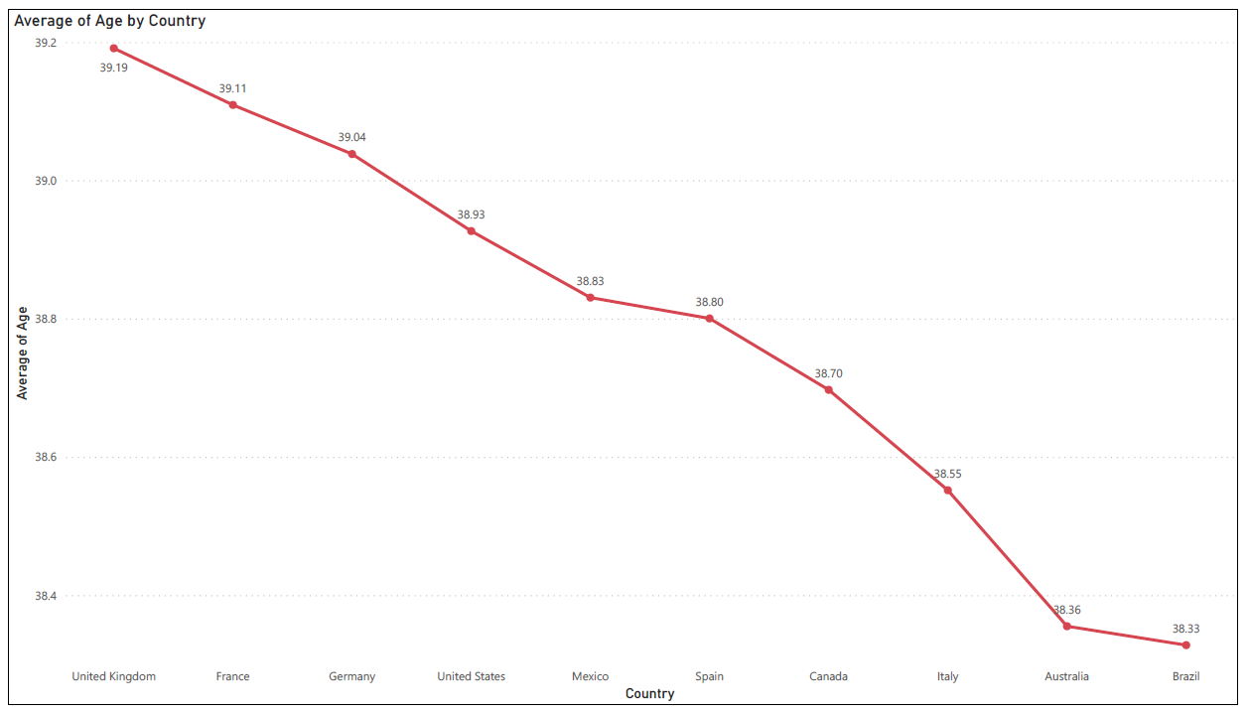
Chart

Slide 6
Gender Report per Country

Slide 7
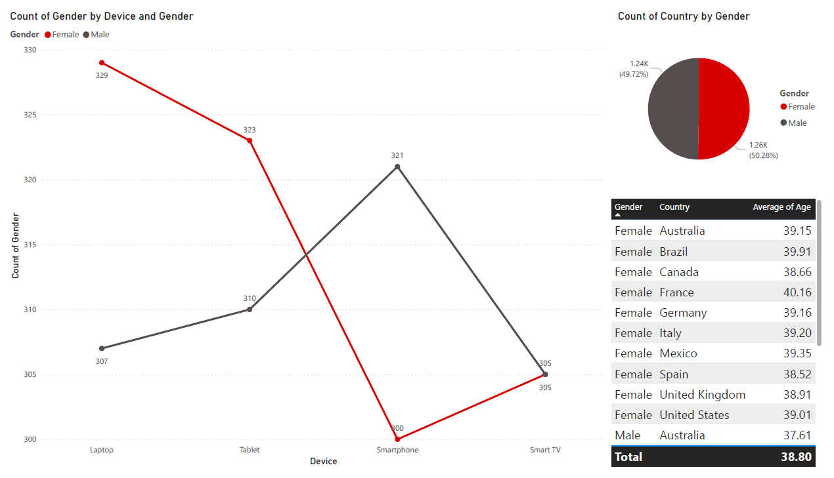
Chart

Slide 8
Monthly Revenue per Country

Slide 9
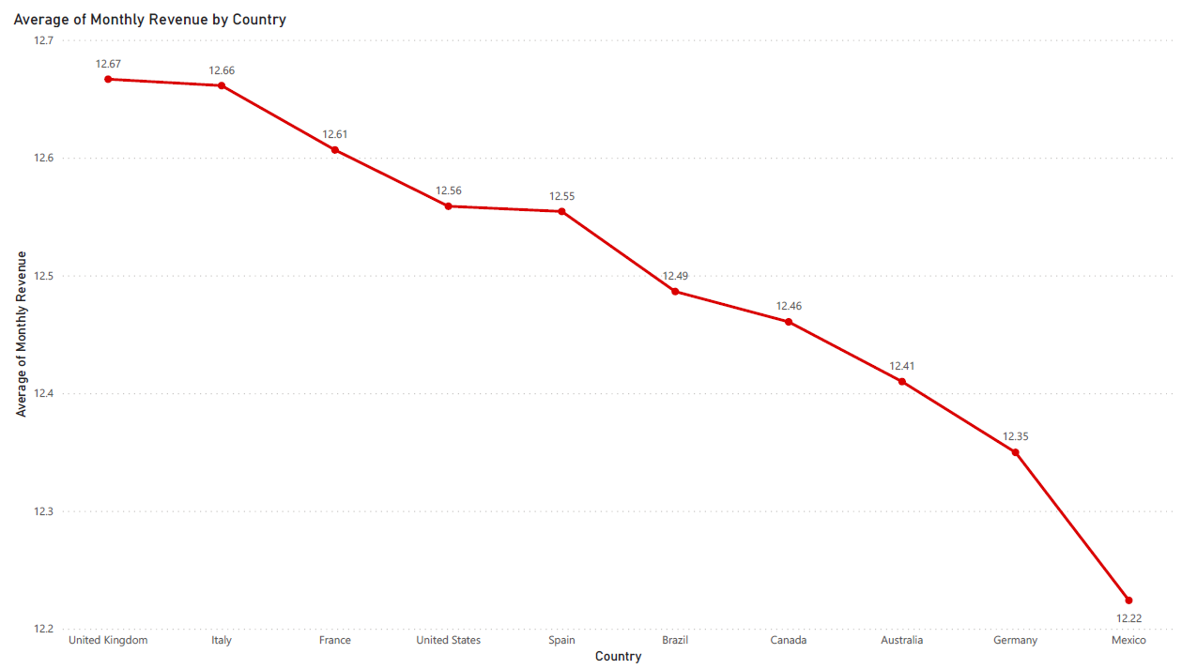
Chart

Slide 10
Subscription Type and Device

Slide 11
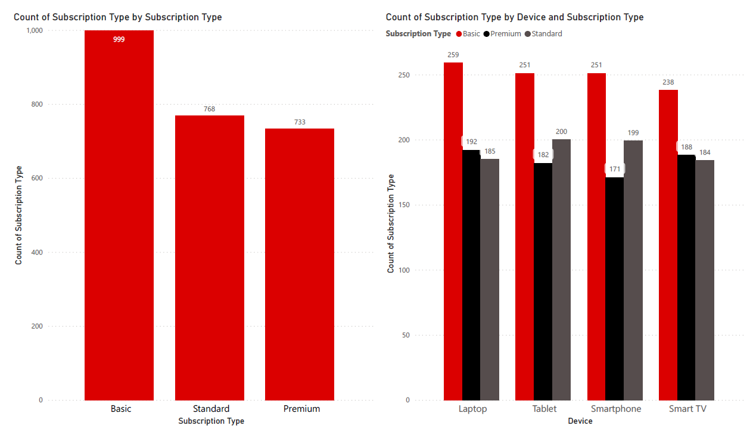
Chart

Slide 12
Dashboard

Slide 13
